Slide 1
Exceptions
Java 2
Object Oriented Programming Essentials CPRG 251

Slide 2
Introduction
In creating a program there are many areas where errors may occur
Some errors are introduce inadvertently by the programmer
Some errors are unexpected and are outside of the programmer’s control
Object Oriented Programming Essentials CPRG 251

Slide 3
Agenda
Types of errors (5 min)
Types of defined Exceptions (5 min)
User defined Exceptions (20 min)
Test harness (10 min)
Object Oriented Programming Essentials CPRG 251

Slide 4
Types of Errors
Syntax
  Improperly constructed statements
  Missing semicolons, brackets etc
  Misspelled names
Detected by the compiler
Elimination of these errors does not guarantee all errors are removed from the program
Object Oriented Programming Essentials CPRG 251

Slide 5
Types of Errors
Logic
  are detected at run time
  often does not produce a message
  messages produced may be obscure “Null Pointer Exception”
  does produce wrong results
  create test cases to eliminate logic errors
Object Oriented Programming Essentials CPRG 251

Slide 6
Exceptions
Exceptions are situations that arise (usually unexpected) that your program must handle; for example:
  A network connection is dropped
  A required file is inadvertently deleted
Java defines many exceptions:
  FileNotFoundException
  NullPointerException
  IndexOutOfBoundsException
Object Oriented Programming Essentials CPRG 251

Slide 7
Exception Handling
Exception handling in Java separates business logic from exception handling logic making it easier for a programmer to understand what the program is doing.
Exceptions in Java are objects of classes that are derived from class Exception.
When an exception is caused (thrown) an appropriate exception handler will be invoked to handle it (catch it).
Object Oriented Programming Essentials CPRG 251
Notes:
All types of exceptions comes from the Exception class (like the Object class)
2003/5/23
Assignment 1 set 3

Slide 8
Exceptions
May be classed into different categories
  Defined Exceptions
    Exceptions that already exist in Java
  User defined Exceptions
    Programmers can define their own exceptions. Create a class to handle user defined exceptions.
Object Oriented Programming Essentials CPRG 251

Slide 9
Defined Exceptions
May be furthered divided into categories
  Checked: Those exceptions that must be checked (try catch or thrown)
      FileNotFoundException
      IOException
      We must take care of these because they are checked
  Unchecked:Not required to check
      ArrayIndexOutOfBounds
      NumberFormatException
      Not mandatory to take care of these, but you can handle them if you want.
Object Oriented Programming Essentials CPRG 251

Slide 10
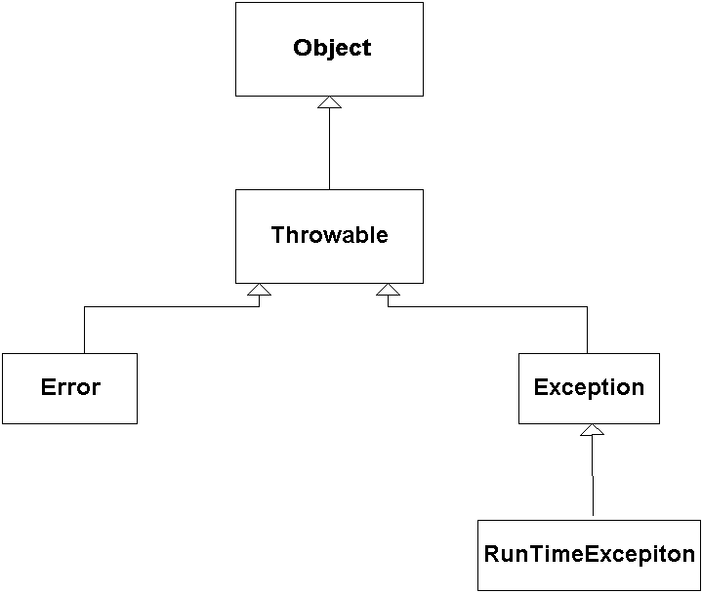
Exceptions Inheritance Structure
Object Oriented Programming Essentials CPRG 251

Slide 11
Exceptions
Checked errors directly extend Exception
  Checked errors must either throw the error or have a try/catch block to handle the error
Unchecked errors extend RuntimeException or Error
  May throw the error or have a try/catch block to handle the error but it is not necessary
Object Oriented Programming Essentials CPRG 251

Slide 12
Exception Handling Format
try block
catch block
Optional finally block
try
{
  Statements that could cause an exception
}
catch(ExceptionClass e)
{
statements to handle exception
}
finally
{
statements to be executed regardless
}
Object Oriented Programming Essentials CPRG 251

Slide 13
The Basics of Java Exception Handling
The programmer encloses code that may generate an exception in a try block.
A try block is immediately followed by one or more catch blocks.
Each catch block handles a specific class of exception and contains code to handle it.
Object Oriented Programming Essentials CPRG 251

Slide 14
The Basics of Java Exception Handling
When an exception is thrown, program control leaves the try block and the catch blocks are searched in order for an appropriate handler.
If one is found then the code in the catch block is executed.
If one is not found then Java searches for an appropriate exception handler for the try block that encloses the current try block.
Object Oriented Programming Essentials CPRG 251

Slide 15
Try Block
Contains statements that may cause an exception
Starts with the word try
Enclosed by {}
Object Oriented Programming Essentials CPRG 251

Slide 16
Catch Block
Must be associated with a try block
Each try block must have at least one catch block (may have more than one)
Has a parameter of an exception object
Contains code to exception object exceptions
Starts with the word catch
Enclosed with {}
Object Oriented Programming Essentials CPRG 251

Slide 17
Finally Block
Optional block associated with a try block
Is always executed if any exception is thrown
Used to clean up after an exception
Starts with the word finally
enclosed within {}
Object Oriented Programming Essentials CPRG 251

Slide 18
User Defined Exceptions
Define a class that extends Exception
At minimum
  Define default constructor
  Define a constructor with a String parameter
    Use super to use the parent constructor
  Create a method that throws the exception
Object Oriented Programming Essentials CPRG 251

Slide 19
User Defined Exceptions
See SquareRootNegative example
Object Oriented Programming Essentials CPRG 251

Slide 20
Summary
Syntax errors
Logic errors
Exceptions
User defined exceptions
Object Oriented Programming Essentials CPRG 251

Slide 21
Where to Get More Information
Exception Handling document
Big Java: Chapter 11
Object Oriented Programming Essentials CPRG 251

